Slide 1

What is an API? - YouTube

Slide 2
API
Application Programming Interface

Slide 3

An API is an intermediary between a primary service and a secondary service.

Slide 4
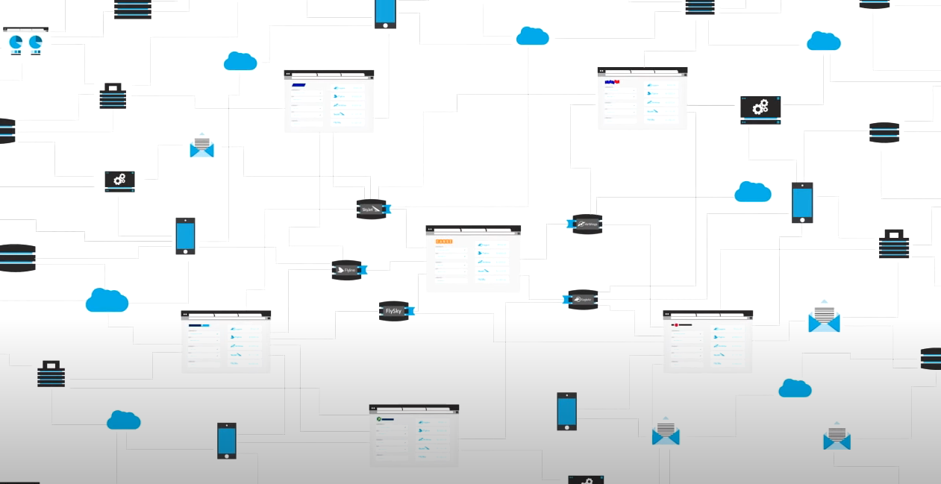
API
Way for programs (or software) to speak to each other

Slide 5
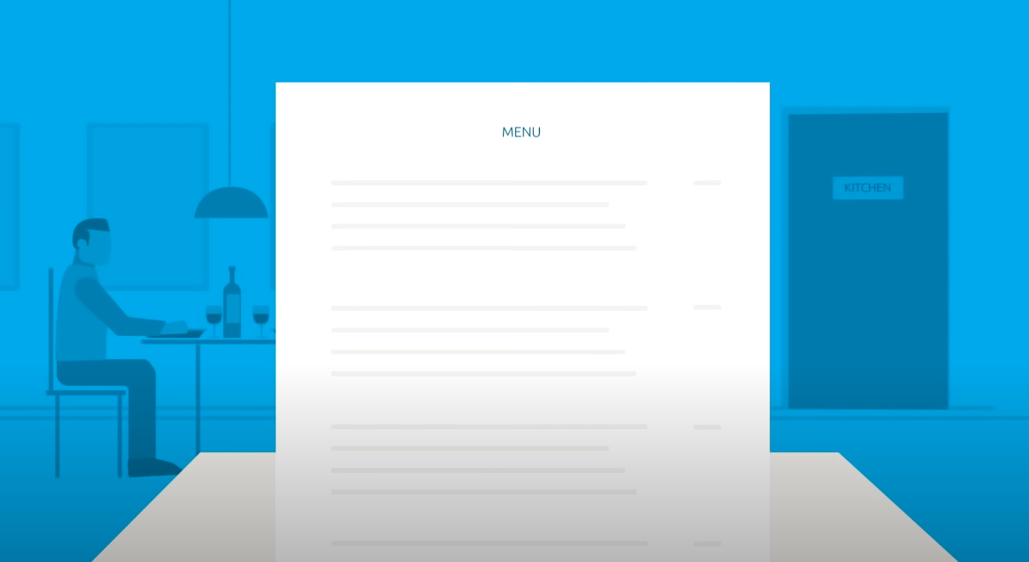
API
You’ll send a request and get back information

Slide 6


API
It saves you from having to write code when you can use someone else’s information
For example, let's say you wanted to create an app that shows how to get to the nearest dog park.
We don’t have to create our own google maps. We can use their existing API.

Slide 7
Call an API using:
console application
browser
desktop application
mobile application
etc

Slide 8

Client
client - application or software that consumes or interacts with an API.
The client sends requests to the API and receives responses in return.

Slide 9

JSON
Javascript Object Notation

Slide 10

JSON
We will call web APIs and receive a response containing JSON.

Slide 11

JSON
(JavaScript Object Notation) is a lightweight data-interchange format.
It is easy for humans to read and write.
It is easy for machines to parse and generate.
Efficient data transfer
Platform independent - ( can be consumed by different types of clients)

Slide 12
JSON
Two structures:
1) Objects-- curly braces { }
2) Arrays-- square brackets[ ]

Slide 13
JSON
Two structures:
1) JObject
2) JArray

Slide 14
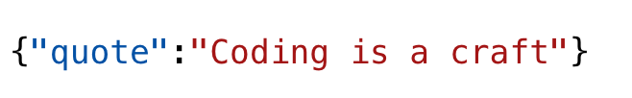
JSON Object

Slide 15
JSON Object
Name Value

Slide 16
JSON Object

Slide 17
JSON Object
I would use the name to grab the value

Slide 18
JSON Array

Slide 19
JSON Array
Array one one item (one string)

Slide 20
JSON Array
We know it’s an array because of the brackets

Slide 21
JSON Array
Guess who said it

Slide 22

JSON Array
Ron Swanson

Slide 23
JSON Array
Index 0

Slide 24

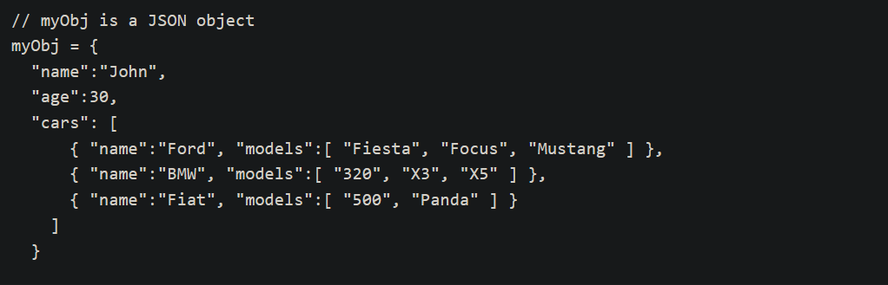
JSON Object

Slide 25
Object has three values
The value of “cars” is an array of three objects

Slide 26
This array has three objects
0
1
2

Slide 27
We’ll try to grab this value

Slide 28
Use indexing!

Slide 29
myObj[“cars”][0][“name”] = “Ford”

Slide 30
If I wanted to grab “Fiesta”

Slide 31
myObj[“cars”][0][“models”][0] = “Fiesta”

Slide 32
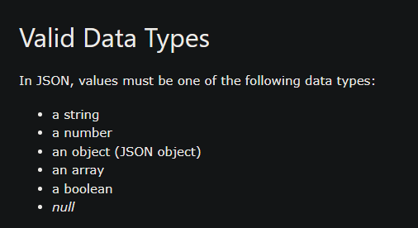
JSON Data Types
JSON Data Types (w3schools.com)

Slide 33
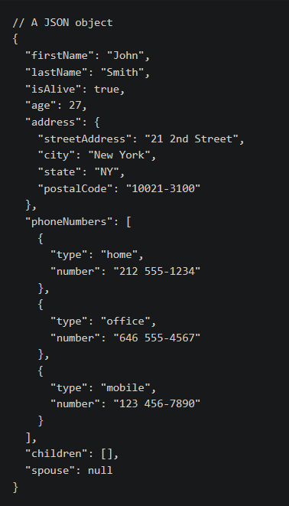

Slide 34
Newtonsoft.Json
Need to install this NUGET package!

Slide 35
Newtonsoft.Json
popular library for JSON processing
Has these classes: JObject and JArray
JObject and JArray represent different types of JSON structures.

Slide 36


When you hear API think REST

Slide 37
API’s Utilize REST
REST: Representational State Transfer
What is a REST API? | IBM

Slide 38

REST
Architectural Style
A REST API follows a client-server model, where the client (like a web application) interacts with the server (the API) over HTTP (Hypertext Transfer Protocol)

Slide 39
API’s Utilize REST
REST is a language-independent architecture that provides interoperability between computer systems on the Internet.
It utilizes a stateless protocol aiming for fast performance and reliability.

Slide 40
Stateless
Session state is entirely on the client.
Each request from the client to the server is self-contained and doesn't rely on the server's previous state.
The client keeps hold of the information and sends a pre-packaged request/series of packets to the server.
Nothing is stored on the server.

Slide 41
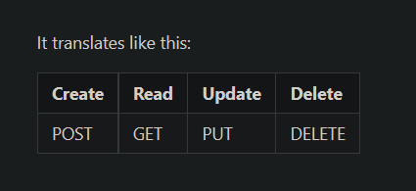
REST Verbs
A RESTful API is an application program interface that uses HTTP requests to GET, PUT, POST and DELETE data.
HTTP (Hypertext Transfer Protocol) is the foundation of any data exchange on the Web.
HTTP requests are used to perform actions on the web server. The main HTTP methods used by RESTful APIs are:

Slide 42
REST Verbs
A RESTful API is an application program interface that uses HTTP requests to GET, PUT, POST and DELETE data.
POST - Create a new resource on the server.
GET - Retrieve data from the server (ex. fetching a resource).
PUT - Update a resource on the server.
DELETE - Remove a resource from the server.

Slide 43
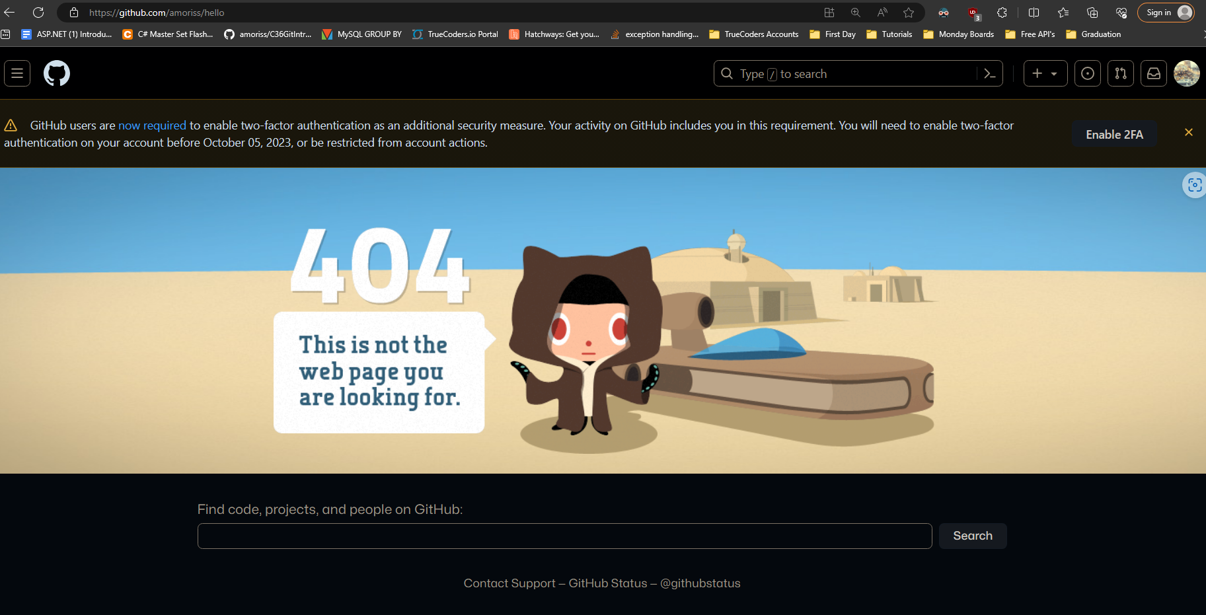
HTTP Status Codes:
HTTP Status Codes are three-digit numbers returned by a server in response to a client's request, such as a web browser's request for a web page.
These status codes are part of the HTTP (Hypertext Transfer Protocol) response and are intended to inform the client about the outcome of its request.

Slide 44
HTTP Status Codes:
1xx – Informational
2xx – Success
This class of status code indicates that the client's request was successfully received, understood, and accepted.
3xx – Redirection
The client must take additional action to complete the request.
4xx – Client Error
(Like 404 Page Not Found)
The 4xx class of status code is intended for cases in which the client seems to have erred. Except when responding to a HEAD request, the server should include an entity containing an explanation of the error situation, and whether it is a temporary or permanent condition. These status codes are applicable to any request method. User agents should display any included entity to the user.
5xx – Server Error
The server failed to fulfill an apparently valid request

Slide 45
Text to an Object
Will receive JSON text back → need to parse it into an OBJECT
C# is an object-oriented language
We need to convert data into objects
We will be parsing to do this!

Slide 46

Things we need to get started:
URL endpoint
Newtonsoft.Json Nuget Package (allows us to parse)
HTTP Client (to send requests)
Recommended: Download Postman to your desktop
Download Postman | Get Started for Free

Slide 47

Postman acts as a Client to send requests

Slide 48

Postman allows us to read our data in a “prettier” format

Slide 49
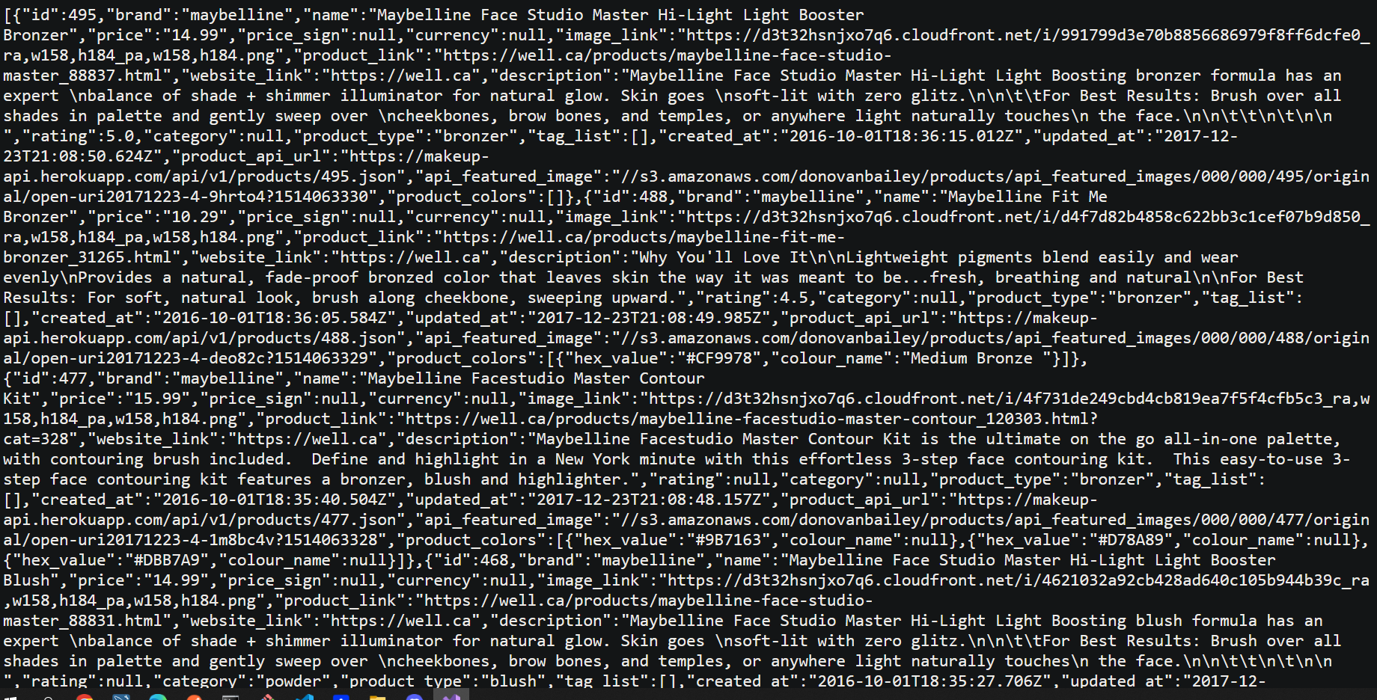
https://makeup-api.herokuapp.com/api/v1/products.json?brand=maybelline

Slide 50
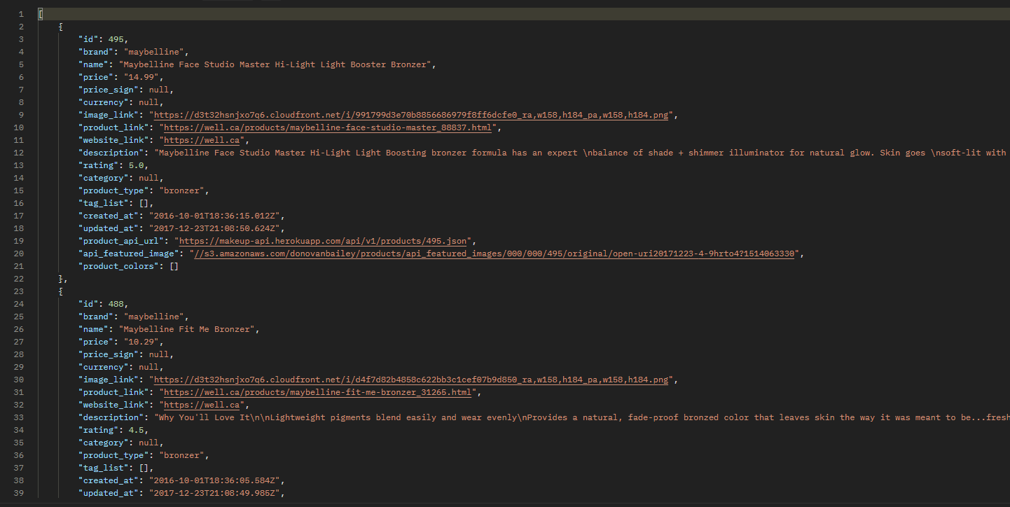
https://makeup-api.herokuapp.com/api/v1/products.json?brand=maybelline

Slide 51
(Reminder) Things we need to get started:
URL endpoint
Newtonsoft.Json Nuget Package (allows us to parse)
HTTP Client (to send requests)
Recommended: Download Postman to your desktop
Download Postman | Get Started for Free

Slide 52

Notes for Exercise 2
MUST create openweatherMap account
and activate key with link sent to email!
URL EndPoint to find weather by city in Fahrenheit:
https://api.openweathermap.org/data/2.5/weather?q={city name}&appid={API key}&units=imperial

Slide 53


